Slide 1

Operating System
Presented By:
Elizer Ponio Jr.

Slide 2
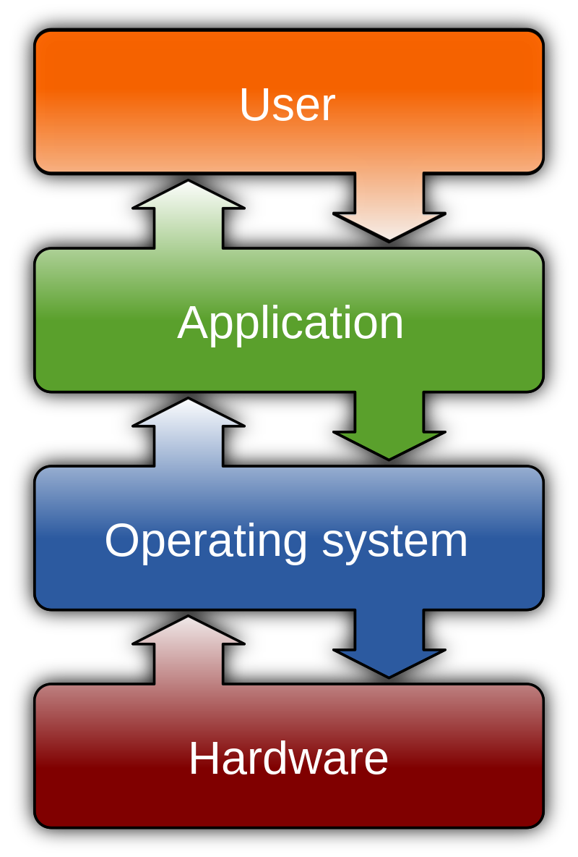
What is an Operating System?
The operating system (OS) manages all of the software and hardware on the computer. It performs basic tasks such as file, memory and process management, handling input and output, and controlling peripheral devices such as disk drives and printers.

Slide 3
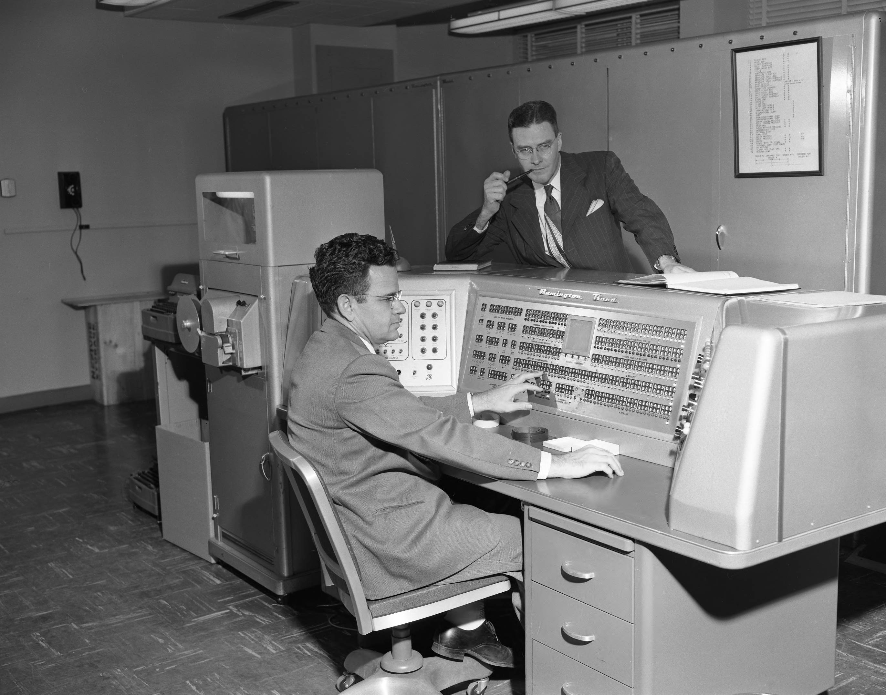
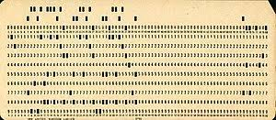
History of the Operating System
Computers in the 1940’s and 1950’s ran one program at a time.
Programmers wrote computer programs in punched cards.

Slide 4
History of the Operating System
Punched cards were handed to a dedicated human operator that fed each card one at a time to the computer.
Human operators were tasked to schedule when the next program could be fed into the computer.
The computer would then process each program,
produce an output and stop.
Running a program often took hours, days or
even weeks.

Slide 5
History of the Operating System
But as computers became faster and faster, they were able to process punched cards tasks quicker than the cards would be fed in by a human operator.
Because of this, humans needed to find a way where the computer must operate by themselves. Thus the operating system was born.

Slide 6
History of the Operating System
Released in April 1981, The Xerox Star 8010 Information System was the first commercial computer with a graphical user interface (GUI). It also incorporated many features that are now considered standard in modern computers, including a bitmapped display, windows, folders, icons, Ethernet networking, file and print servers, and the mouse.

Slide 7
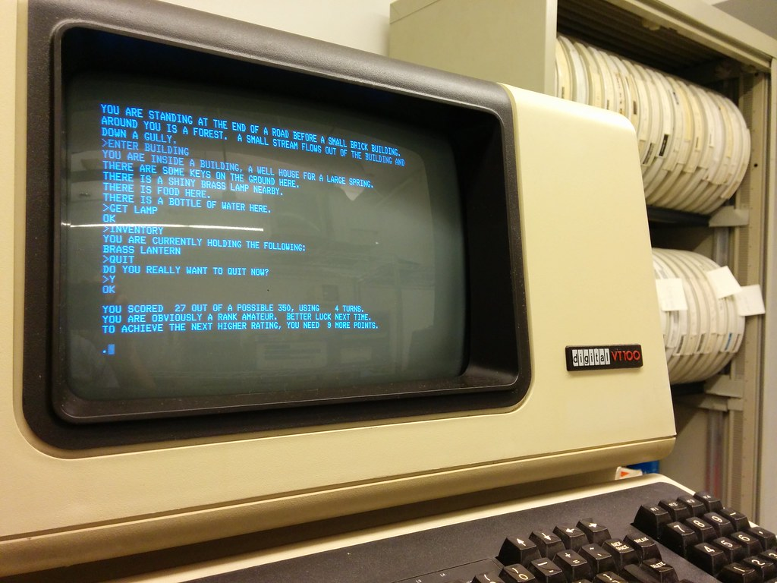
History of the Operating System
UNIX, a command line interface OS first released in 1969.

Slide 8
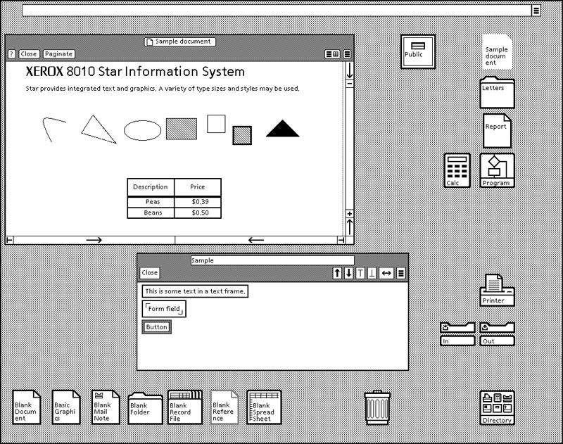
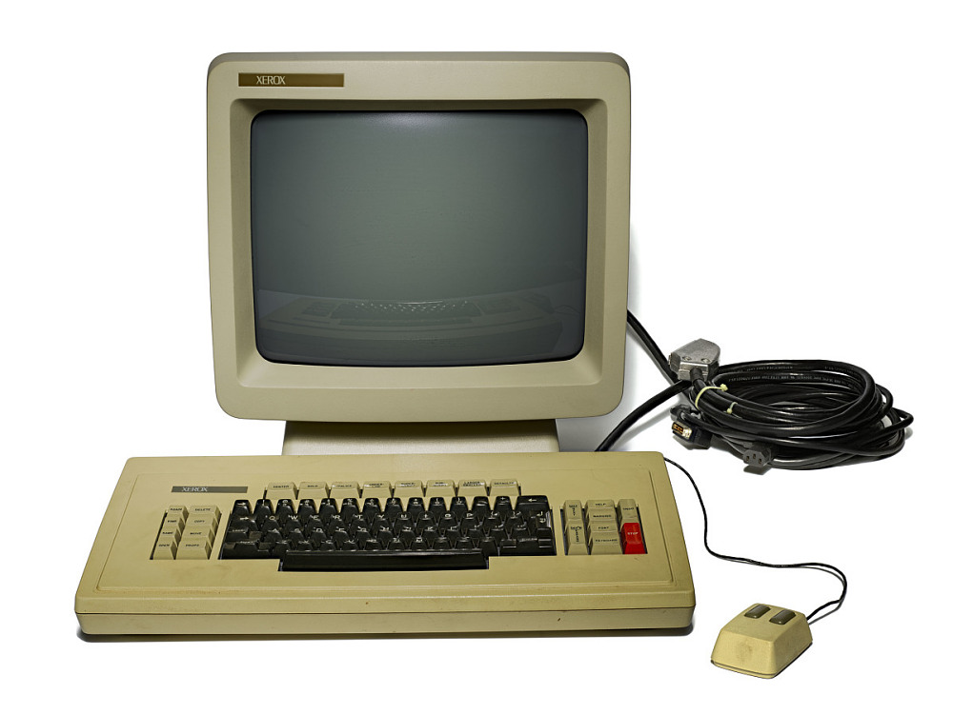
History of the Operating System
Xerox Star Information System

Slide 9
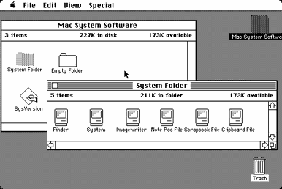
History of the Operating System
Macintosh “System 1” released in 1984

Slide 10
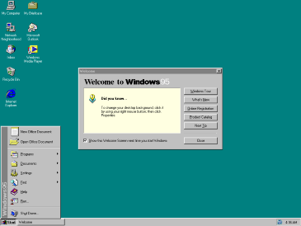
History of the Operating System
Microsoft Windows 95 released in 1995

Slide 11
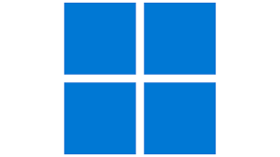
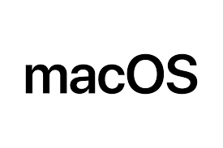



Modern Operating Systems
Desktop OS
Mobile OS

Slide 12

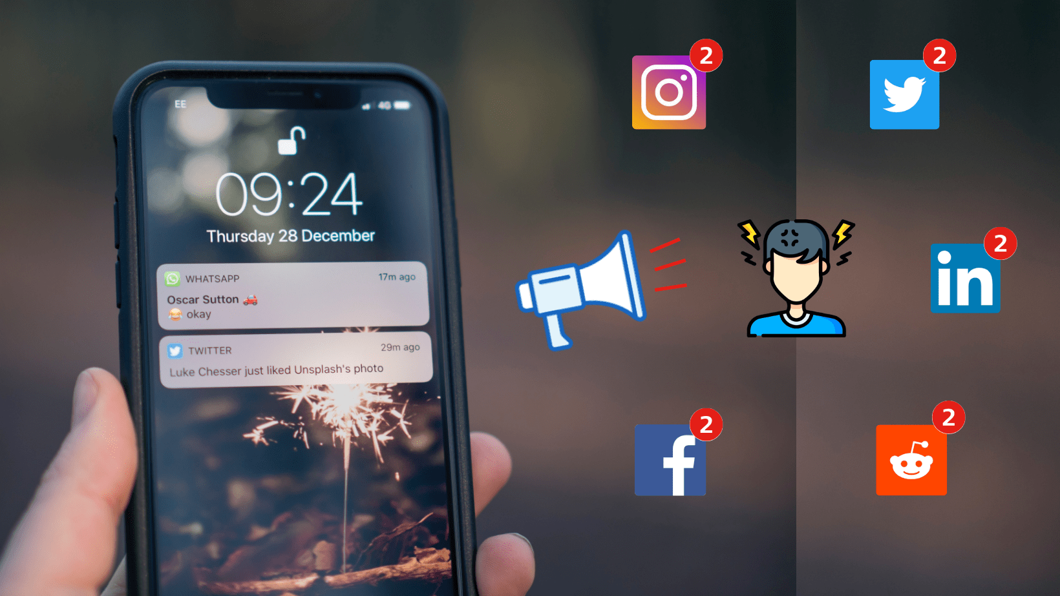
Modern Operating Systems
Social media networks pervade the environment of operating systems through notifications.

Slide 13
Elements of an Operating System
User Interface. A user interacts with the operating system through the user interface.
Kernel. The kernel is responsible for loading and operating programs or processes, and managing input and output.
File Management System. The file management system is what the operating system uses to organize and manage files.

Slide 14
Elements of an Operating System
File and folder management. An operating system creates a file structure on the computer hard drive where the data can be stored and retrieved
Applications management. Whenever a program is requested the operating system locates it and loads into the primary memory or RAM.

Slide 15
Elements of an Operating System
Support for built-in utility programs. The operating system comes with tools for maintenance and repairs. They identify the problem, they find lost files, repair the damaged ones and do backups for your data.
Computer hardware control. Operating systems facilitates the access of programs to the computer hardware through the BIOS and through device drivers.

